Slide 1
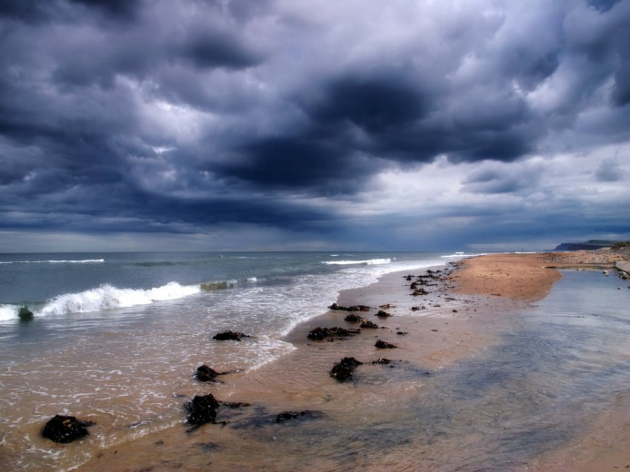
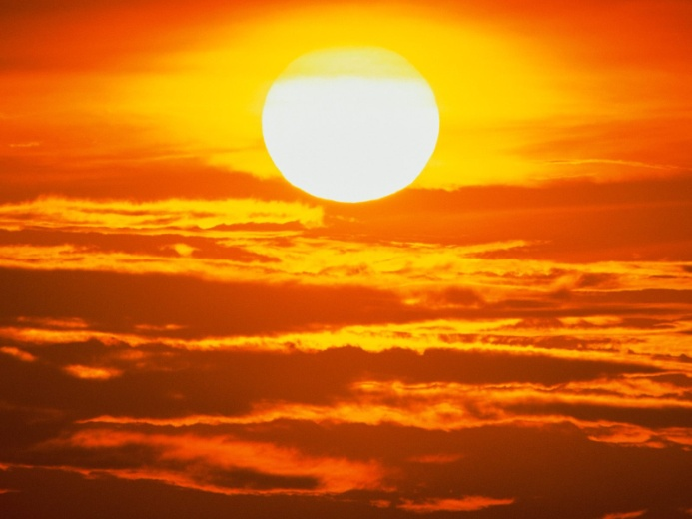
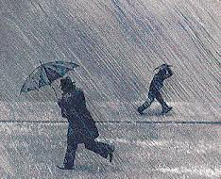
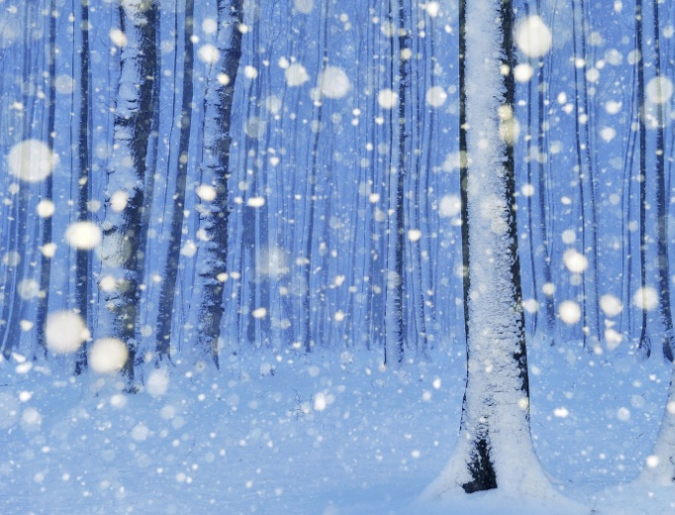
Basic 06
How´s the weather?

Slide 2
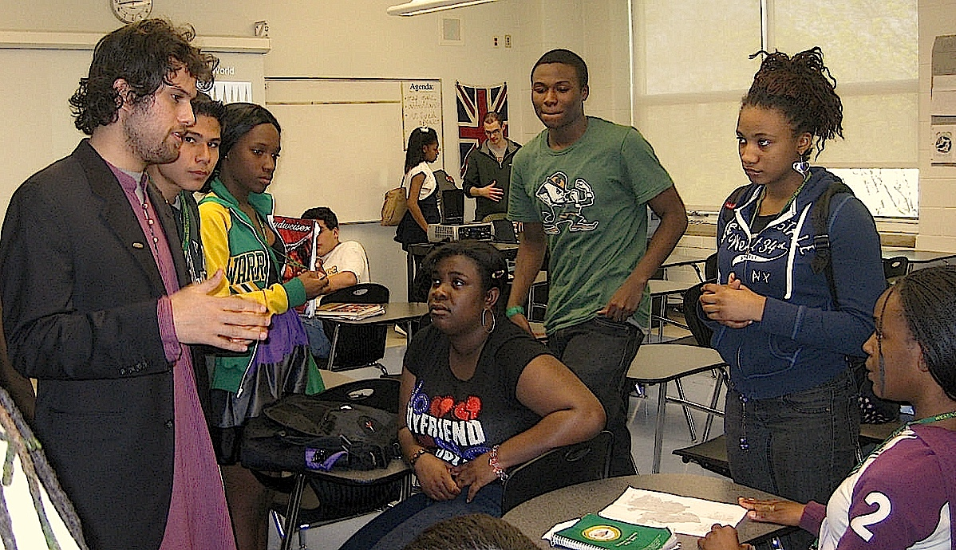
Connecting sentences with but, or, so

Slide 3
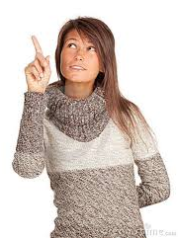
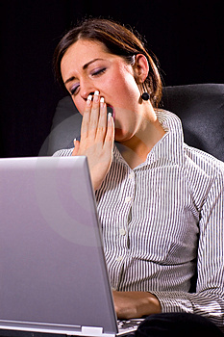
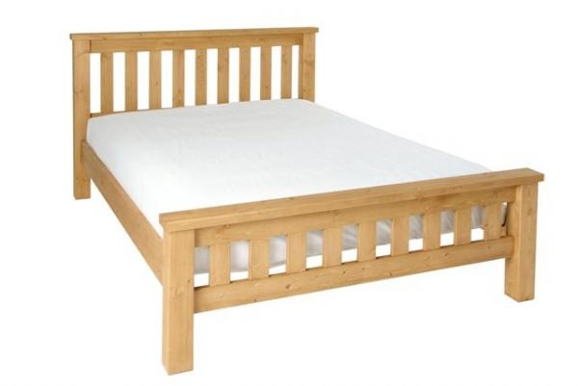
Maria is cold,
so
she is wearing a sweater.
Fatima is tired,
so
she is going to sleep.

Slide 4
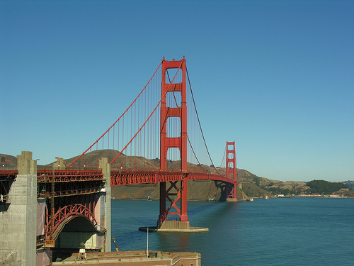
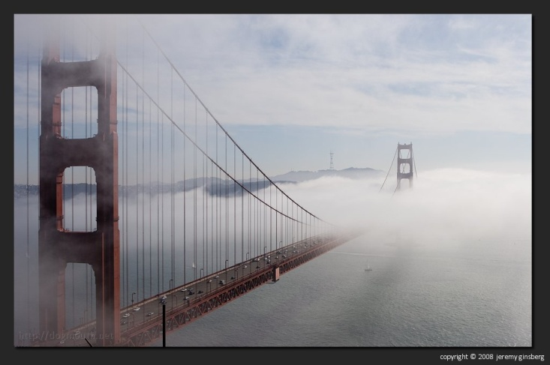
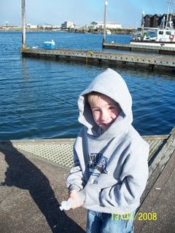
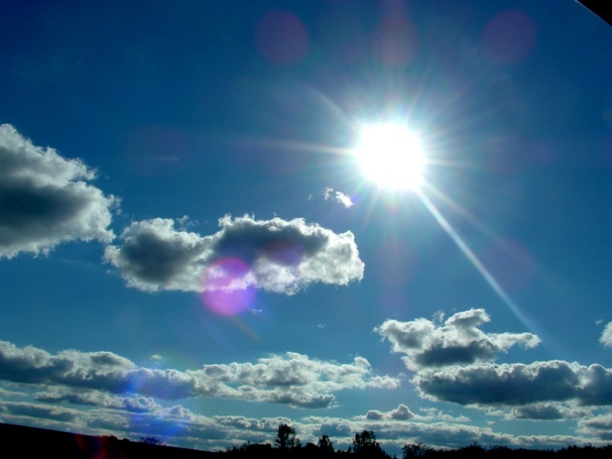
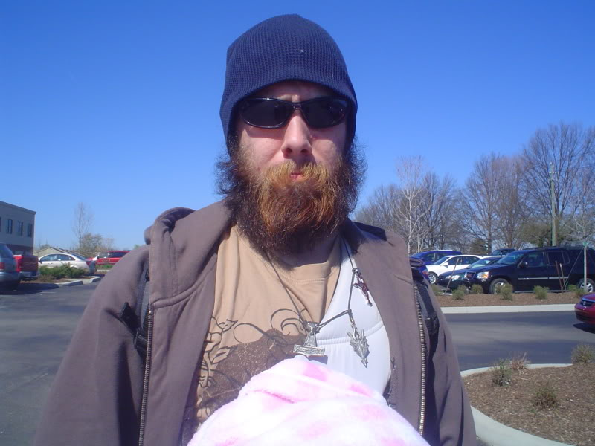
It is usually foggy in the mornings,
but
it’s sunny during the day.
Sometimes it’s sunny
but
chilly in the afternoons.

Slide 5
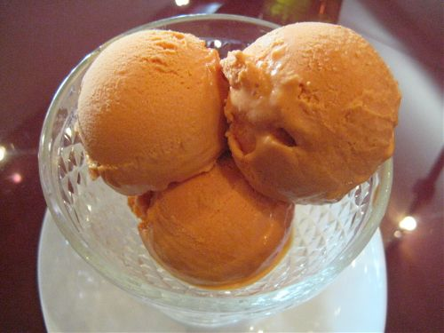
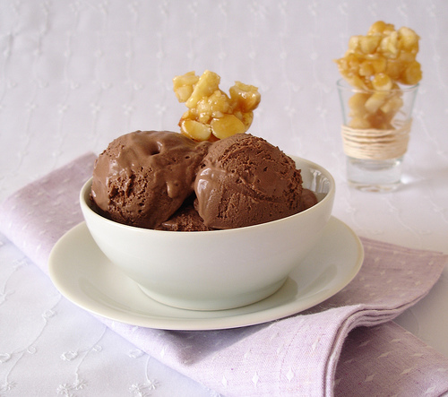
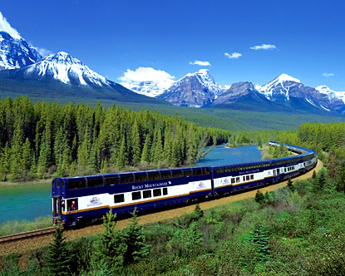
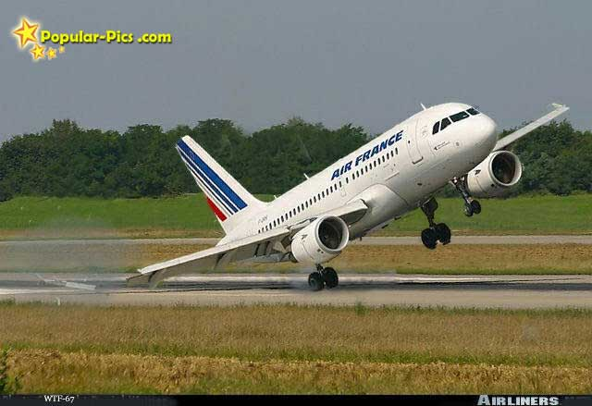
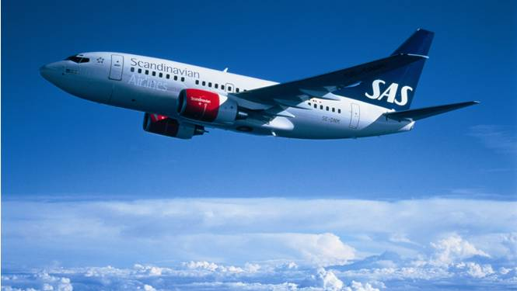
or
lucuma ice cream?
Do you want chocolate
We can fly to Cuzco ,
or
we can take a train to Cuzco.

Slide 6
Complete the sentences:
or
We can take a bus ____walk to the store.
My parents are traveling ____ I can have a party at home. ☺
It’s very hot today ____ I’m going to the beach.
You should study ___ you can get a bad grade.
My uncle can drive a car ___ he can’t rive a motorcycle.
We can watch Shrek 3 ____ Le Foo.
Reza can’t dance ____ he is in the competition.
I have a car now ____ I spend more money in gas(gasoline)
, so
, so
, or
, but
or
, but
, so

Slide 7


Slide 8

You´re awesome!

